Slide 1
Qualitative Modeling of Aircraft Geometries for Comparison with Numerical Methods
Joel Lubinitsky
John F. Dannenhoffer, III
Aerospace Computational Methods Lab
Syracuse University

Slide 2
Background
Vehicle Sketch Pad designed for 3 dimensional visualizations, with emphasis on ease of use.
Engineering Sketch Pad designed for construction of geometries and analysis of their sensitivities to certain parameters.
Baseline human performance necessary for meaningful evaluation of optimization methods.
Quality of Geometry
Time Spent
Aircraft models needed to demonstrate principals to new users. (Tutorial)

Slide 3
Objective
To increase familiarity with solid modelling of aircraft and ultimately design parametric geometry for comparison to geometry created through optimization methods.

Slide 4
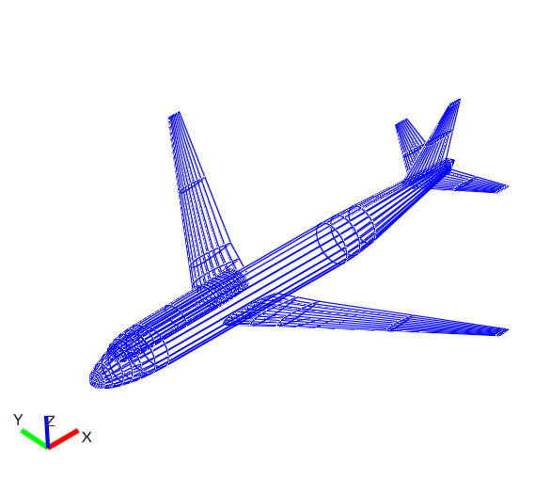
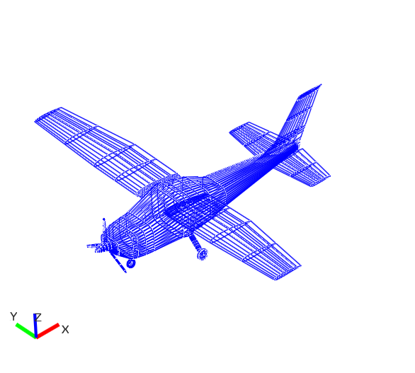
OpenVSP
Boeing 747-400
Cessna 182

Slide 5
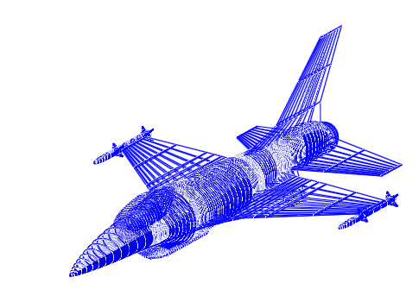
F16 Fighting Falcon OpenVSP
Build Time:
Approx. 8-10 hrs
Estimated Rebuild Time:
Approx. 4-5 hrs

Slide 6
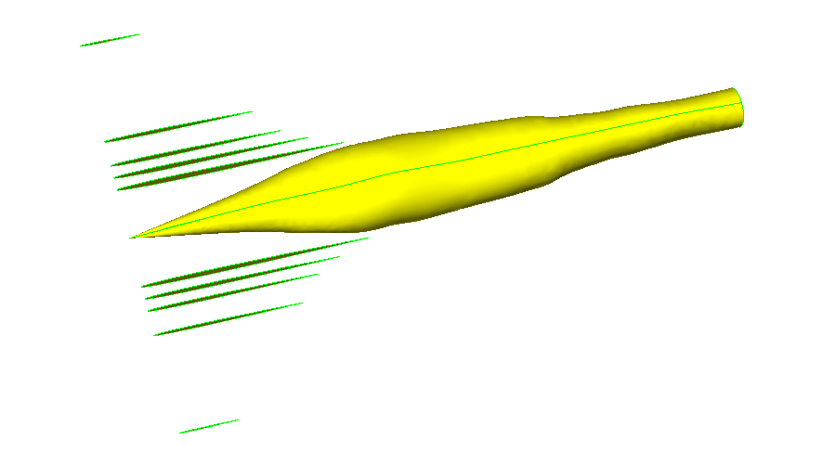
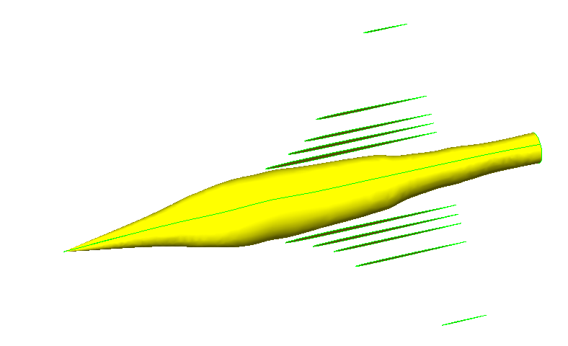
Engineering Sketch Pad
Cross-Sections
Translation

Slide 7
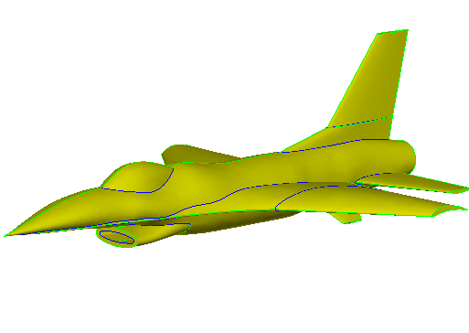
F16 Fighting Falcon ESP
Build Time
Approx. 20 hrs
Estimated Rebuild Time
Approx. 7-8 hrs
Rendering Time (From Scratch)
14 min

Slide 8
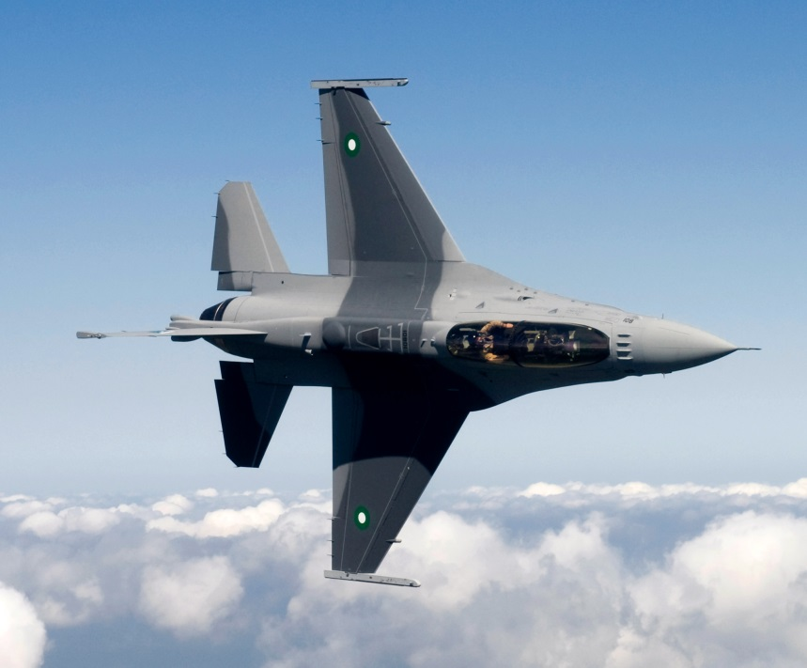
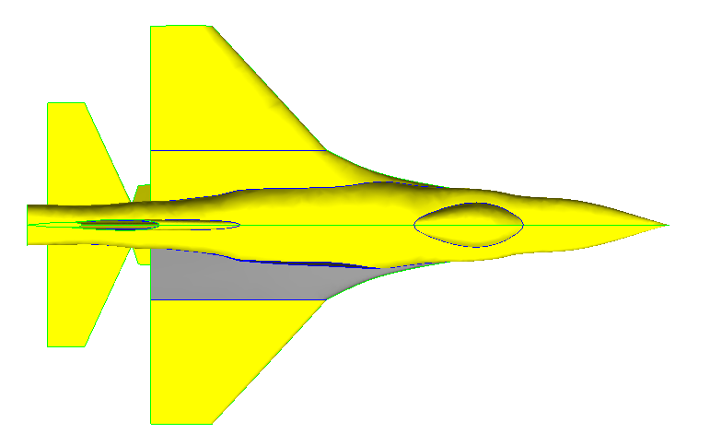
Goodness of Fit
ESP
Real Life
"Pakistani F-16" by United States Air Force - USAF news article (direct link). Licensed under Public domain via Wikimedia Commons

Slide 9
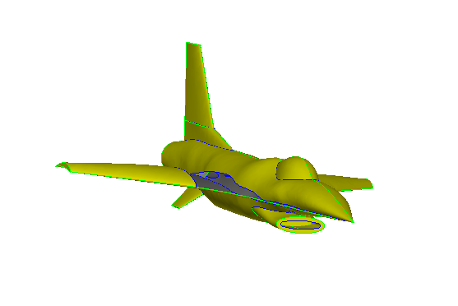
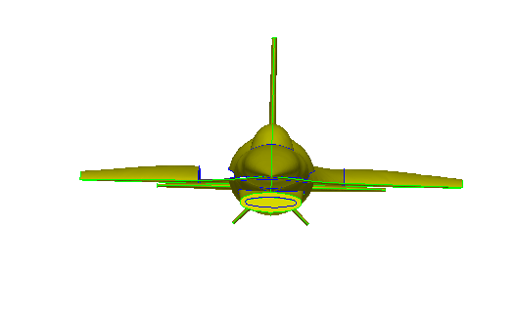
Existing Issues
Not Generating Wing Face
Air Intake is Elliptical

Slide 10
Conclusion
Produced complete aircraft model.
Fix remaining problems.
Break down into steps/write up tutorial.
Successfully determined baseline rate for construction of F16 Fighting Falcon.
Continue to design other models at more experienced pace.

